Slide 1
An Introduction to Flutter
Don Ward
Quicken Loans
Senior Research Engineer
donward@quickenloans.com
@donwardpeng

Slide 2


Who am I?
Quicken Loans Mobile Team
100 Days of Code on Flutter
GDG Detroit for 7 years
GDG Windsor ~ 1 year

Slide 3
The Agenda
What is Flutter?
What is Dart?
Why?
Let’s code!

Slide 4

What is Flutter?
Open Source Cross Platform Mobile Development
Announced 2015
Flutter 1.0 – Dec 2018
Flutter 1.5 – May 2019
Flutter 1.9 – Sept 2019
Available on iOS, Android, ChromeOS and Web

Slide 5
What is Dart?
Since 2011
Statically typed language similar to JavaScript and Java
Object-oriented
Syntactic sugar

Slide 6

‘Why?’

Slide 7
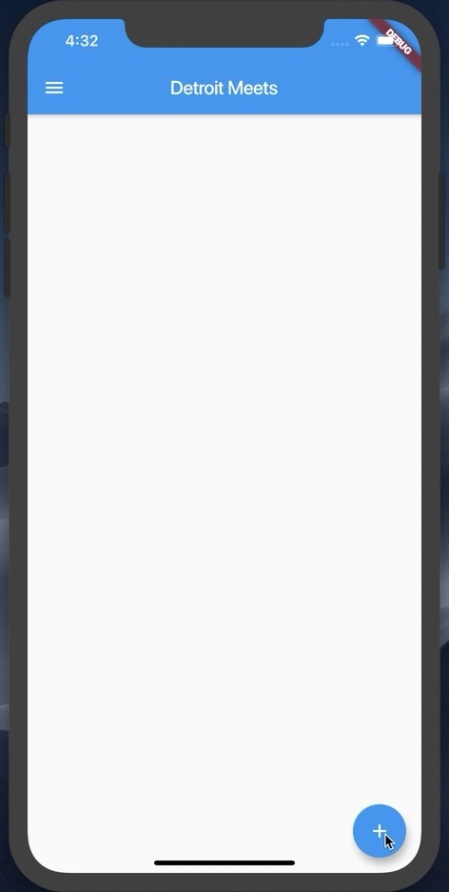
What are we building today?

Slide 8
Let’s start
Flutter SDK installed
Visual Studio Code installed
Android emulator or iOS simulator running
https://github.com/donwardpeng/DetroitMeets-FlutterIntro

Slide 9
Let’s talk about the Command Line Tool (CLI)
‘flutter doctor’
‘flutter create <app_name>’
In the <app_name> directory -> ‘flutter run’
Hot Reload and Restart
While running, type ‘h’

Slide 10
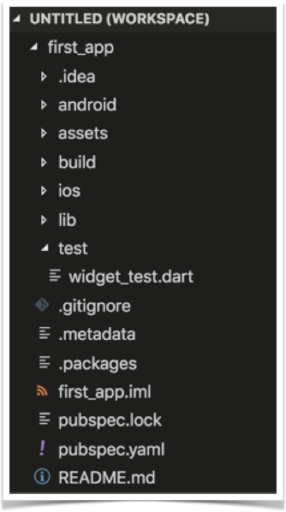
Project Structure

Slide 11
Let’s start from scratch
In VS Code, open the main.dart file
Wipe it clean
Add the code below
//Example 1
import 'package:flutter/material.dart';
void main() {}

Slide 12
Let’s attach something to the screen
The runApp method
In Dart, ‘=>’ is equivalent to {return expr};
//Example 2
import 'package:flutter/material.dart';
void main() => runApp(<Widget>);

Slide 13
‘Let’s talk about Widgets’

Slide 14
Widgets
Everything is a widget
Stateless Widgets
Stateful Widgets
class StatelessWidgetExample extends StatelessWidget{};
class StateFullWidgetExample extends StatefulWidget{};

Slide 15
Let’s create our first Widget
//Example 3
import 'package:flutter/material.dart';
void main() => runApp(MyApp());
class MyApp extends StatelessWidget{
@override
Widget build(BuildContext context) {
// TODO: implement build
return null;
}
}

Slide 16
Let’s add some Material Design
//Example 4
@override
Widget build(BuildContext context) {
return MaterialApp(
title: ‘CUCSC Conference’,
);
}
}

Slide 17
‘Exciting Stuff! Let’s talk about Constructors!’

Slide 18
Widgets & Constructors
Positional and Named Parameters
Named Parameters declared with {}

Slide 19
The Text Widget
Text(String data, { Key key, TextStyle style, StrutStyle strutStyle, TextAlign textAlign, TextDirection textDirection, Locale locale, bool softWrap, TextOverflow overflow, double textScaleFactor, int maxLines, String semanticsLabel })

Slide 20
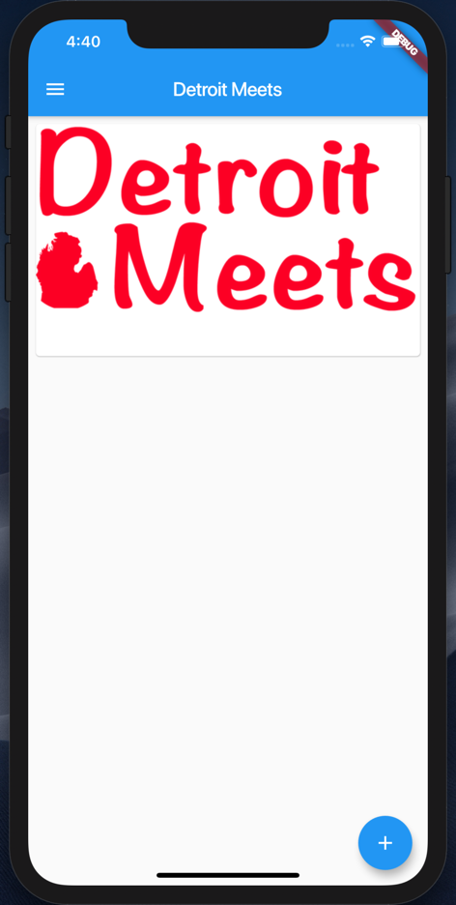
Let’s add some Widgets
Add a Card per Image
Add a Floating Action Button

Slide 21
Add a Scaffold for the Screen
//Example 5
return MaterialApp(
title: Detroit Meets',
home: Scaffold(
appBar: AppBar(
title: Text(‘Detroit Meets'),
),
));

Slide 22
Add a Card to the Body
//Example 6
home: Scaffold(
appBar: AppBar(title:Text(‘Detroit Meets’),),
body: Card(child: ,));
}
}

Slide 23
Add a Column to the Card
//Example 7
... appBar: AppBar(
title: Text(‘Detroit Meets’),
body: Card(child: Column(children: <Widget>[],),
),
));
}...

Slide 24



Let’s add some images
Steps:
Create a new assets folder and add images
Modify pubspec.yaml file

Slide 25
Add a Image to the Card
//Example 8
...
child: Column(
children: <Widget>[
Image.asset(‘assets/detroit_meets.jpeg'),
],
),...

Slide 26
Guess what – Padding is a Widget
//Example 9
Below the Image...
Padding(padding: const EdgeInsets.all(8),
),
],
),
)));...

Slide 27
Margin is inside a Widget
//Example 10
...
body: Card(
margin:EdgeInsets.all(8),
child: Column(
children: <Widget>[
Image.asset(‘assets/detroit...'),
...

Slide 28
ListViews give us scroll
//Example 11
...
body: ListView(
children: <Widget>[
Card(
margin: EdgeInsets.all(8),
child: Column(
...

Slide 29
Let’s add a Floating Action Button
//Example 12
...
body: ListView(children: <Widget>[
...
floatingActionButton: ,));

Slide 30
Let’s add a FAB object
//Example 13
...
floatingActionButton: FloatingActionButton(
child: const Icon(Icons.add),),
));

Slide 31
onPressed() for the FAB
//Example 14
floatingActionButton: FloatingActionButton(
child: const Icon(Icons.add),
onPressed: () {}),
));

Slide 32
Everything is in place now. Let’s wire up the button and images to the list.
WARNING: BOILERPLATE CODE AHEAD

Slide 33
Let’s add a list of Images
//Example 15
class MyApp extends StatelessWidget {
// Declare a set list of images to cycle through
final List<Image> _itemImages = [
Image.asset('assets/detroit_cityscape.jpg'),
Image.asset('assets/detroit_meets.jpeg'),
Image.asset('assets/tigers-d.jpg')
];
int _index = 0;
List<Image> _listOfImagesForScreen = [];

Slide 34
Boiler Plate Alert – A Stateful Class
//Example 16
class MyApp extends StatefulWidget {
@override
State<StatefulWidget> createState() {
return _MyAppState();
}
}
class _MyAppState extends State<MyApp> {

Slide 35
Let’s make the button do something
//Example 17
//Add to the main class above the build method
void onButtonPressed() {
setState(() {
_index++;
if (_index >= _itemImages.length) {
_index = 0;
}
_listOfImagesForScreen.add(_itemImages[_index]);
})}

Slide 36
Update the ListView
//Example 18
home: Scaffold(
appBar: AppBar(
title: Text('Detroit Meets'),
),
body: ListView(
children: _listOfImagesForScreen
.map((element) => Card(
margin: EdgeInsets.all(8),

Slide 37
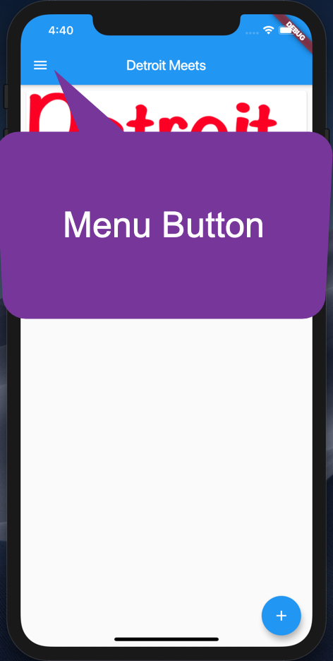
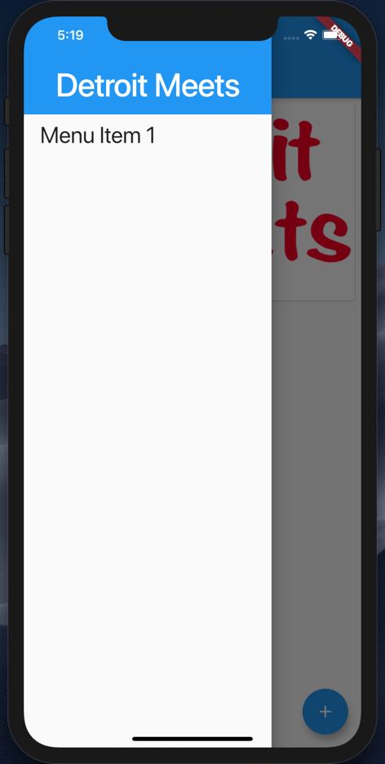
Let’s add a Nav Drawer

Slide 38
A simple Nav Drawer
//Example 19
drawer: Drawer(
child: ListView(
padding: EdgeInsets.zero,
children: <Widget>[
Container(
height: 128.0,
child: DrawerHeader(
child: Text(
'Detroit Meets',
...

Slide 39
What did we learn?
Command Line Tool for Flutter
Project Structure
Widgets
Constructors and Named Parameters
Stateless and Stateful Widgets
A few Widgets ☺
https://github.com/donwardpeng/DetroitMeets-FlutterIntro

Slide 40

Thank you!
Don Ward
Quicken Loans
Senior Research Engineer
donward@quickenloans.com
@donwardpeng

